Slide 1
IoT Threat Modeling

Slide 2
Agenda
Overview of Threat Modeling process
When to threat model, Who performs threat modeling, & What to threat model
Threat Modeling requirements
Microsoft SDL Threat Modeling Tool overview
Benefits and features
Microsoft SDL Threat Modeling Tool steps:
Draw Diagrams
Analyze Model
Describe Environment
Generate Reports

Slide 3
Threat Modeling
Threat modeling for IoT applications involves a structured process where potential threats, such as security vulnerabilities and risks within an Internet of Things (IoT) ecosystem, are identified, prioritized, and countered systematically.
The process typically involves the following key components:
Identifying assets: Pinpointing what needs to be protected, such as data, devices, and services.
Creating an architecture overview: Diagramming network structures, device connections, and data flow to understand how the IoT system is organized.
Enumerating threats: Identifying potential malicious acts and vulnerabilities that could affect the system based on its architecture and external environment.
Mapping threats to risks: Assessing the impact and likelihood of these threats to prioritize them according to the level of risk they pose.
Defining mitigation strategies: Developing approaches to minimize the risks identified, either through technological solutions, policies, or procedural changes.

Slide 4
Threat Modeling Tools
Threat modeling tools are designed to assist security teams in identifying, evaluating, and mitigating risks in application and network designs. Here are several well-regarded tools that are used for threat modeling, including various options tailored for different purposes such as analysis, visualization, and collaboration:
Microsoft Threat Modeling Tool - This is one of the most popular threat modeling tools; it helps identify security vulnerabilities in software architectures. It provides a user-friendly interface and pre-defined templates focused on different types of applications and scenarios.
OWASP Threat Dragon - An open-source tool developed by the OWASP community. It provides diagramming capabilities to visually map data flows and potential entry points for threats, and it includes a rule engine to analyze threats and suggest mitigations.

Slide 5
Microsoft SDL Threat Modeling Overview
Microsoft SDL Threat Modeling: A process to understand security threats to a system, determine risks from those threats, and establish appropriate mitigations
Key requirement for applications developed with the Microsoft SDL
Microsoft SDL Threat Modeling
Diagramming
Threat Enumeration
Mitigation
Validation
Can be performed by both security and non-security experts

Slide 6

Microsoft Security Development Lifecycle (SDL)
Training
Requirem-ents
Design
Implemen-tation
Verification
Release
Response
Delivering secure software requires:
Executive commitment → SDL a mandatory policy at Microsoft since 2004
Education
Technology and Process
Accountability
Ongoing Process Improvements → 6 month cycle

Slide 7
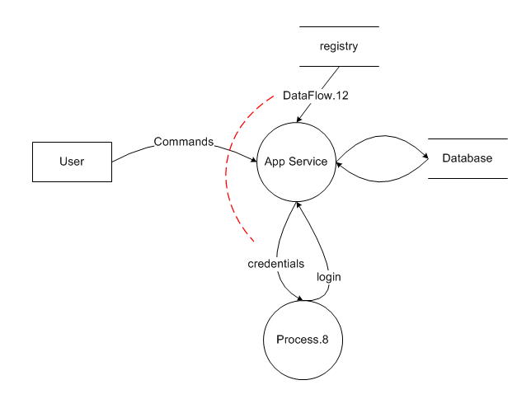

Microsoft SDL Threat Modeling Illustrated
Registry
R
I
✓
S
T
D
E
Database Server
Application Service
Authentication / Authorization
Services

Slide 8
When to Threat Model
Training
Requirem-ents
Design
Implemen-tation
Verification
Release
Response
Best performed during the application design phase
Easiest to make application changes
Less costly than adding mitigations and testing them after code has been implemented and onwards

Slide 9
Who Performs/Drives Threat Modeling?
Threat Modeling process can be performed by:
Security experts
Non-security experts
The threat modeling process should be driven by:
Application designers; however, developers and testers should be involved

Slide 10
What To Threat Model
The application as a whole
Security and privacy features
Features whose failures have security or privacy implications
Features that cross trust boundaries

Slide 11
Top Microsoft SDL Threat Modeling Advantages and Disadvantages
Advantages
Can be used to find threats to a system early in the development process
Can be used by both security experts and non-security experts
Can be used to guide other security assessment activities
Disadvantages
Upfront costs (training, software, and setup)

Slide 12
Threat Modeling Process
Vision
Step 1: Model
Step 2: Enumerate Threats
Step 3: Mitigate
Step 4: Validate
Product
Development

Slide 13
Step 1: Diagramming
Step Objective: To model an application design as a data flow diagram to drive threat analysis
Data flow diagrams (DFDs)
Widely used and easily understood graphical representation
Most attacks based on data flowing through an application or system
Trust boundaries

Slide 14
Data Flow Diagrams (DFDs) Elements
Element | Represented By | Description
External Entity |  | Any entity not within the control of the application, such as people and external systems
Process |  | Code, such as native code executables and .NET assemblies
Data Store |  | Data at rest, such as registry keys and databases
Data Flow |  | How data flows between elements, such as function calls and network data

Slide 15
Additional Element: Trust Boundaries
Element | Represented By | Description
Trust Boundary |  | A point within an application where data flows from one privilege level to another, such as network sockets, external entities and processes with different trust levels

Slide 16
Step 2: Threat Enumeration
Step Objective: To identify threats for each data flow diagram element in the threat model
Experts: Brainstorming and other informal methods
Experts and Non-Experts: STRIDE threat types
Based on Microsoft Security Response Center (MSRC) issues and Common Vulnerability and Exposures (CVE)

Slide 17
Threat Modeling Approach
Threat modeling is to systematically identify and mitigate security risks in IT systems, including software applications and networks.
STRIDE : STRIDE is an acronym that stands for six categories of security threats (Spoofing, Tampering, Repudiation, Information Disclosure, DOS, Elevation of Privilege)
PASTA (Process for Attack Simulation and Threat Analysis) is a risk-centered threat modeling approach.
VAST (Visual, Agile, and Simple Threat). VAST is aimed at addressing the scalability issues posed by traditional threat modeling techniques in large and agile development environments.
OCTAVE (Operationally Critical Threat, Asset, and Vulnerability Evaluation). It is a suite of tools, techniques, and processes for risk-based information security strategic assessment and planning.

Slide 18
STRIDE Threat Types
Desired Property | Threat | Definition
Authentication | Spoofing | Impersonating something or someone else
Integrity | Tampering | Modifying code or data without authorization – modifying things that you are not supposed to modify
Non-repudiation | Repudiation | The ability to claim to have not performed some action against an application – claiming doing things that you did not do or claiming not doing things that you actually did
Confidentiality | Information Disclosure | The exposure of information to unauthorized users
Availability | Denial of Service | The ability to deny or degrade a service to legitimate users - prevent system from providing the service
Authorization | Elevation of Privilege | The ability of a user to elevate their privileges with an application without authorization – do things that they are not supposed to do

Slide 19
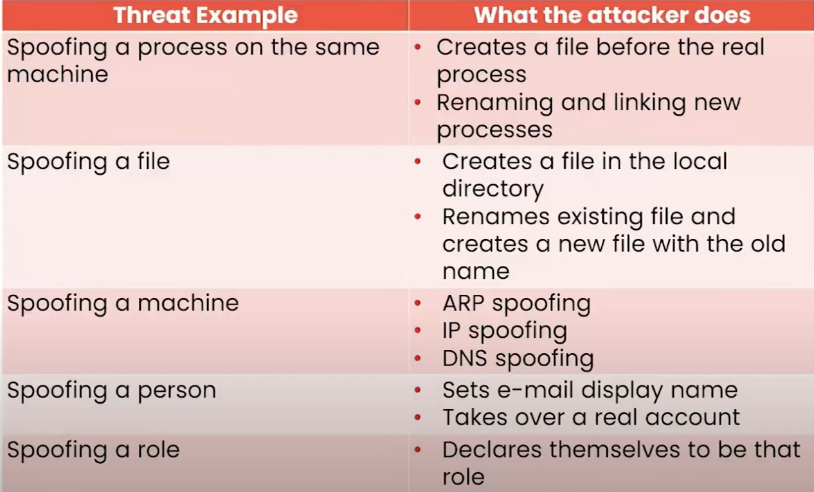
Examples of Spoofing

Slide 20
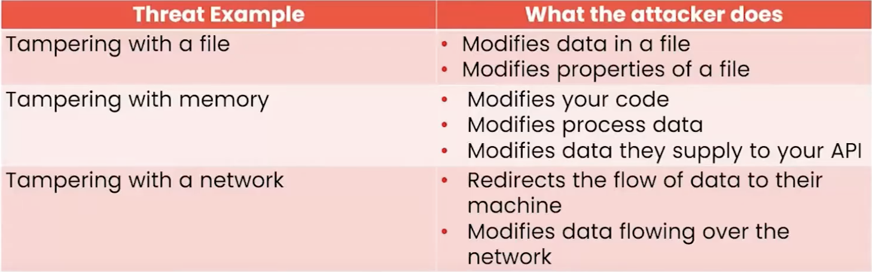
Examples of Tampering

Slide 21
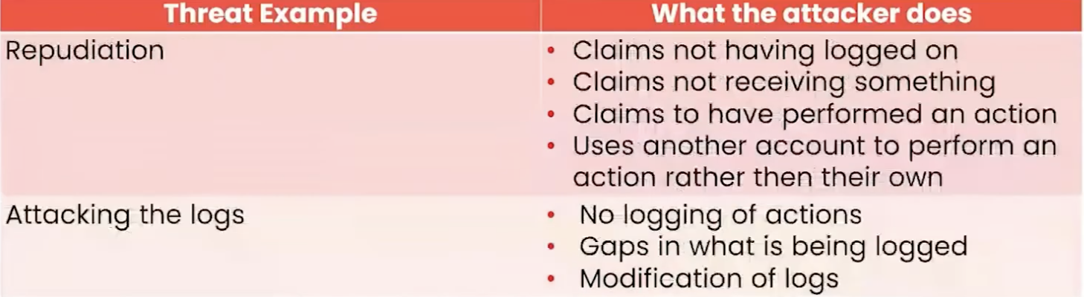
Examples of Repudiation

Slide 22
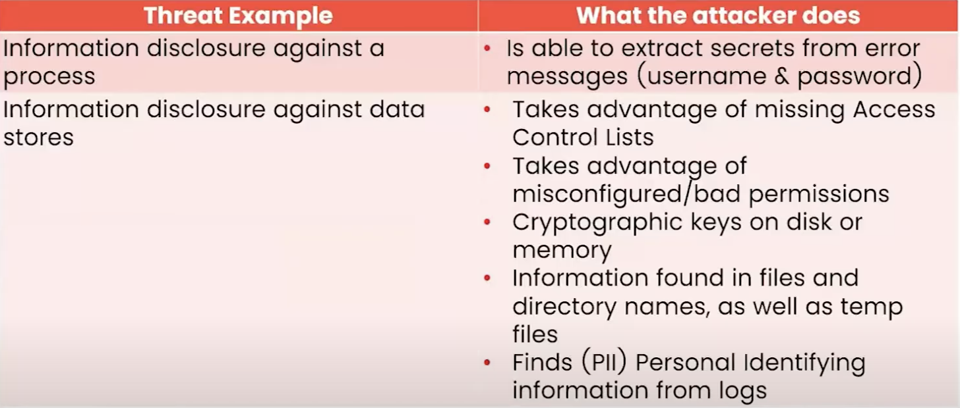
Examples of Information Disclosure

Slide 23
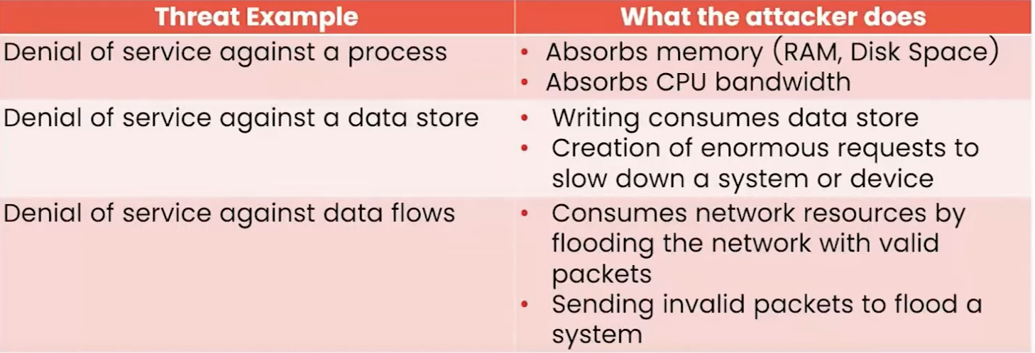
Examples of Denial of Service

Slide 24
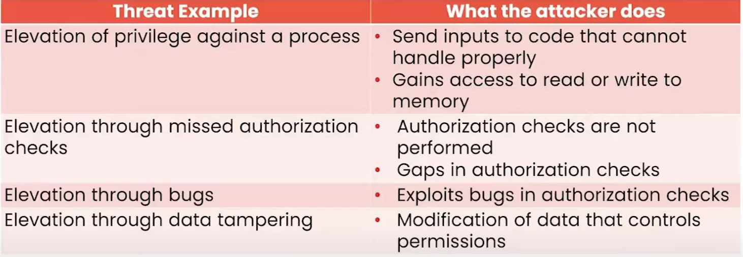
Examples of Elevation of Privilege

Slide 25
Identifying STRIDE Threats by Data Flow Diagram Element Type
Element | S | T | R | I | D | E
External entity |  |  | 
Process |  |  |  |  |  | 
Data Store |  |  |  |  | 
Data Flow |  |  |  |  | 

Slide 26
Step 3: Mitigation
Step Objective: To address identified threats to an application design
Approaches to threat mitigation (in order of preference):
Redesign
Use standard mitigations
Use unique mitigations
Accept risk in accordance with policies

Slide 27
Examples of Standard Mitigations
Threat | Example Standard Mitigations
Spoofing | Ipsec Digital signatures Message authentication codes Hashes
Tampering | ACLs Digital signatures Message Authentication Codes
Repudiation | Strong Authentication Secure logging and auditing
Information Disclosure | Encryption ACLs
Denial of Service | ACLs Quotas High availability designs
Elevation of Privilege | ACLs Group or role membership Input validation

Slide 28
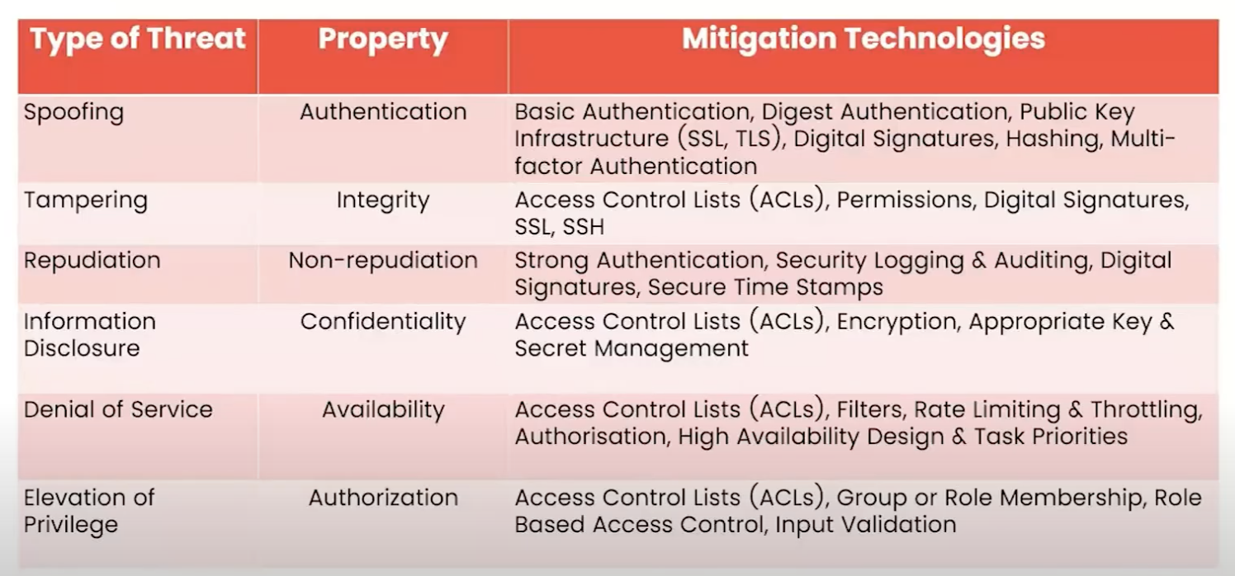
Examples of Mitigation Technologies

Slide 29
Step 4: Validation
Step Objective: To help ensure that threat models accurately reflect application design and potential threats
Validation of the model
Validation of enumerated threats
Validation of mitigations
Validation of assumptions

Slide 30
Microsoft SDL Threat Modeling Requirements
Threat models must:
Be created for all functionality identified during the cost analysis phase (stage 2) of the Microsoft SDL
Meet minimal quality requirements
Be reviewed and approved by at least one developer, one tester and one program manager
Be stored using document control systems

Slide 31
Microsoft SDL Threat Modeling Tool Overview
Microsoft SDL Threat Modeling Tool: A graphical user interface tool that helps application designers create and analyze threat models, document mitigations and create actionable reports
Official Web site:
https://docs.microsoft.com/en-us/azure/security/azure-security-threat-modeling-tool
Microsoft SDL Threat Modeling tool requirements:
Microsoft Vista, Microsoft Server 2008 or higher
Microsoft Visio 2007 or higher
Newer releases are integrated with Microsoft Azure.

Slide 32
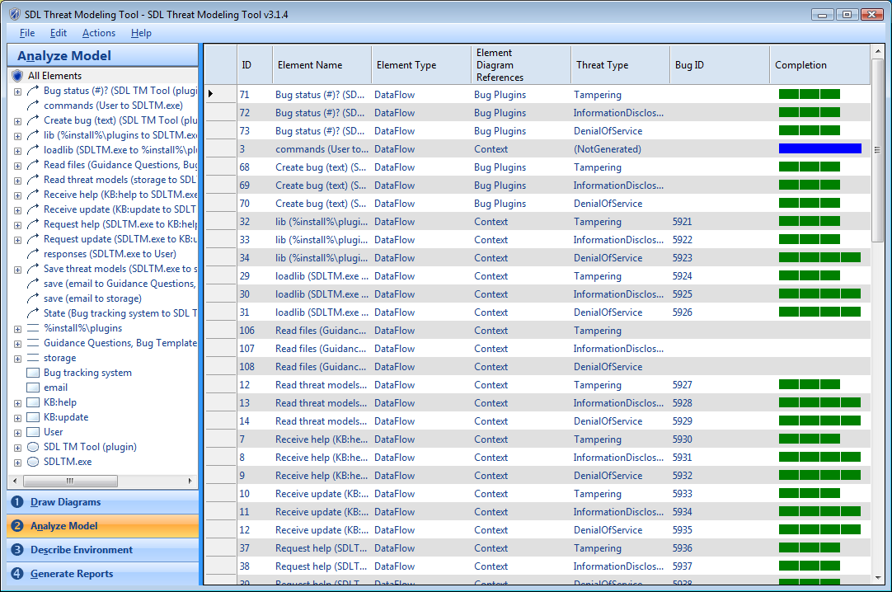
The Microsoft SDL Threat Modeling Tool

Slide 33
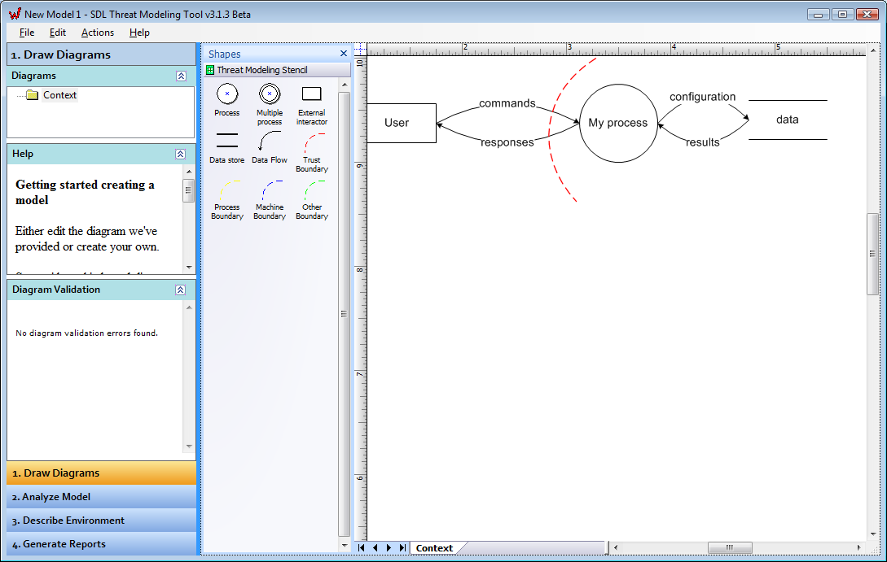
Microsoft SDL Threat Modeling Tool Benefits and Features
Vision
Process automation
Guided analysis of threats and mitigations (STRIDE)
Microsoft Visual Studio Team Foundation Server integration
Reporting capabilities
Step 1: Model
Step 2: Enumerate Threats
Step 3: Mitigate
Step 4: Validate
Product
Development

Slide 34
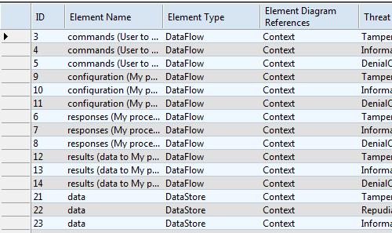
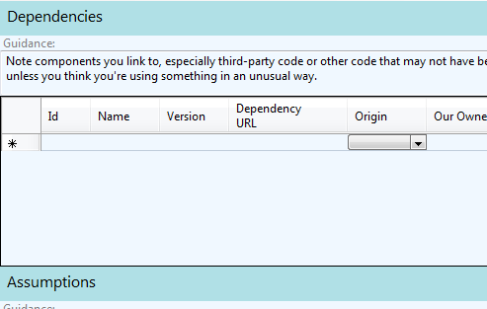
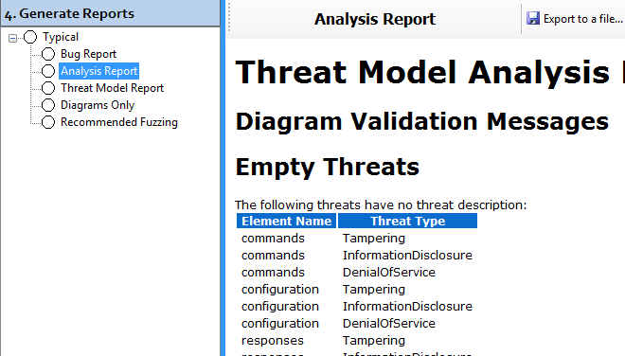
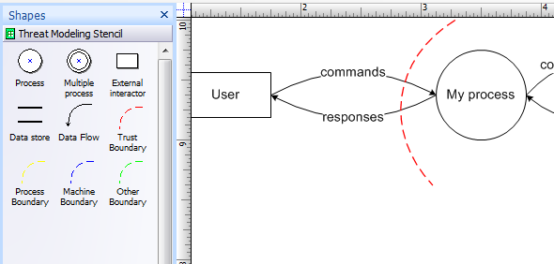
Using the Microsoft SDL Threat Modeling Tool
Four steps to using the Microsoft SDL Threat Modeling Tool:
Draw Diagrams
Analyze Model
Describe Environment
Generate Reports

Slide 35
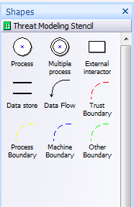
Step 1: Draw Diagrams
Step Objective: To model an application design as a data flow diagram to drive threat analysis

Slide 36
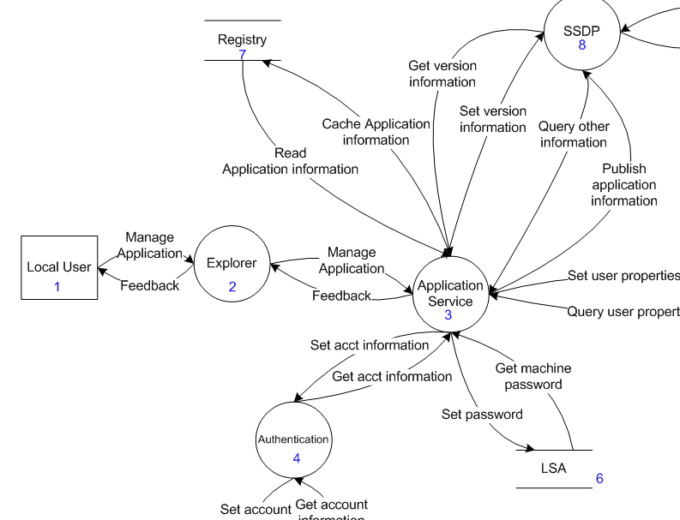
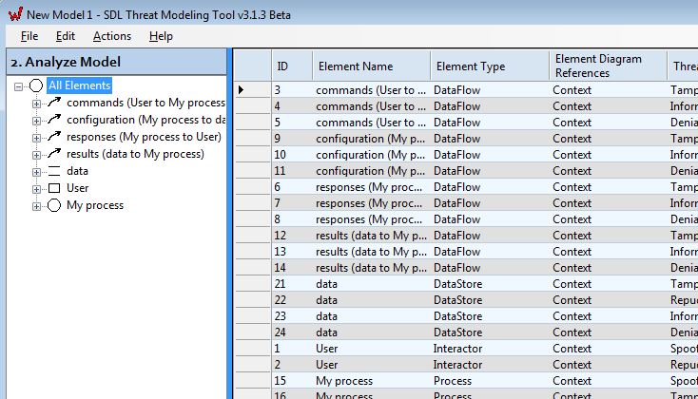
Step 2: Analyze Model
Step Objective: To identify a baseline set of potential threats and mitigations for each data flow diagram element in the threat model
T
M
S
M
E
M
STRIDE
R
M

Slide 37
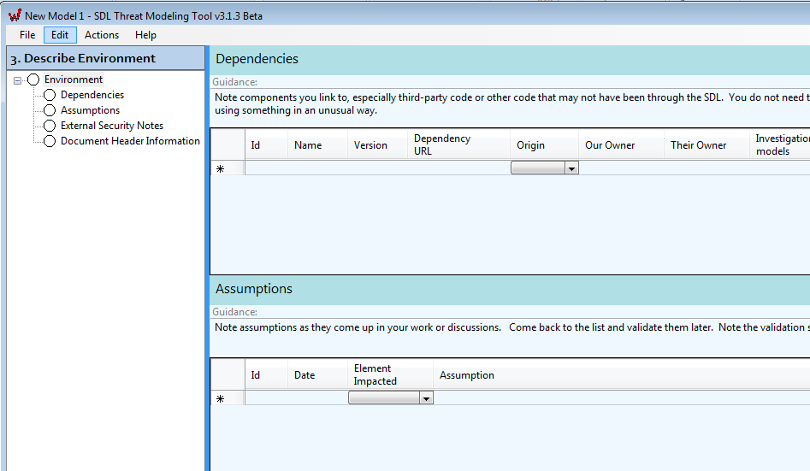
Step 3: Describe Environment
Step Objective: To describe the environment in which the application will be deployed

Slide 38
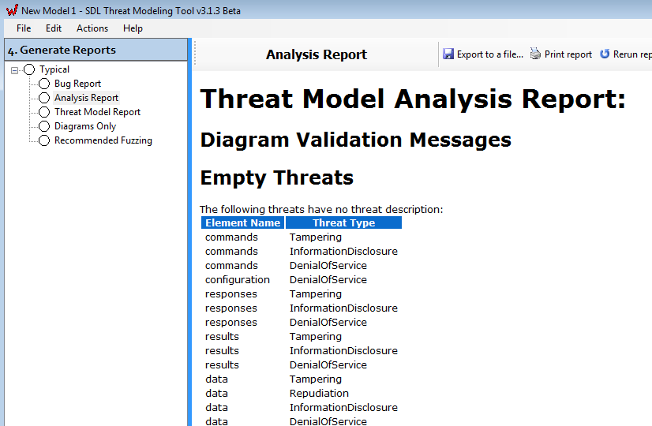
Step 4: Generate Report
Step Objective: To generate threat analysis and mitigation plan reports

Slide 39
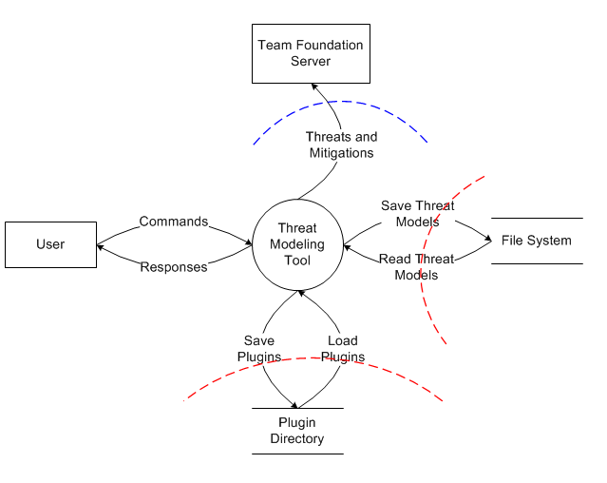
Microsoft SDL Threat Modeling Tool Demonstration
Team Foundation Server
D
M
R
M
Threat Modeling Tool
Saved Reports
T
M
Plugins

Slide 40
Drawing a Threat Model
Suggest using tools
Microsoft TM tools (free)
ThreatModeler (licence)
Starting by drawing high level architecture overview

Slide 41
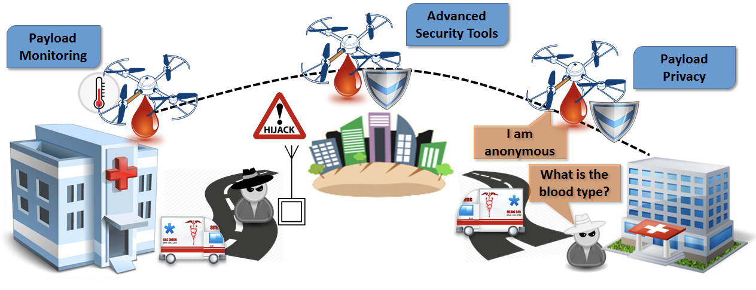
Use Case IoT – Human Blood Delivery using Drone
Technology used:
5G
Cloud
Web and Mobile Apps for management and monitoring
Ref: Sensors 2018, 18, 4015; https://doi.org/10.3390/s18114015

Slide 42
High level Overview Architecture

Slide 43
Conclusion
Overview of the Threat Modeling process
Advantages and disadvantages
Steps of the Microsoft SDL Threat Modeling process
Threat modeling requirements
Microsoft Threat Modeling Tool
Benefits and features
Steps to use the Threat Modeling Tool

Slide 44
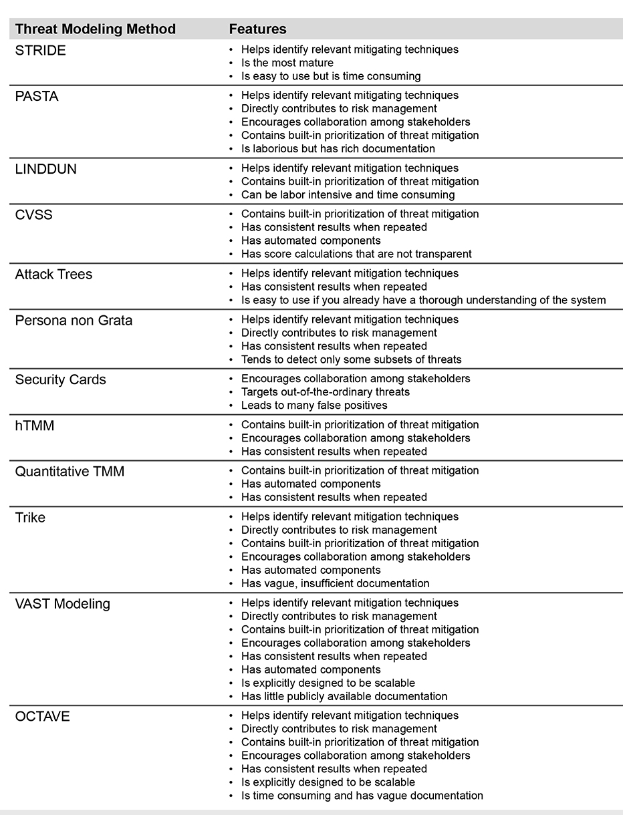
Other Threat Modeling Methods:
https://insights.sei.cmu.edu/sei_blog/2018/12/threat-modeling-12-available-methods.html

Slide 45
5
Q&A

Slide 46
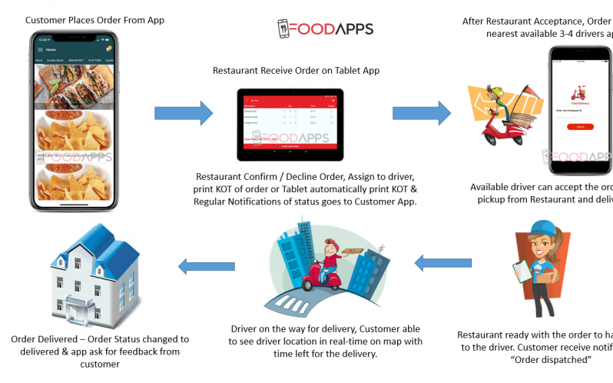
Food Delivery Services

